Slide 1
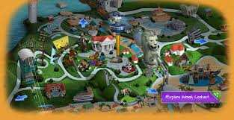
SENTOSA SINGAPORE
40_RAYMONDYEO_1E3

Slide 2
IMMERSE YOURSELF IN 5 DIFFERENT ZONES
DOLPHIN ISLAND
UNDERWATER WORLD
S.E.A AQUARIUM
ADVENTURE COVE
4D ADVENTURELAND

Slide 3
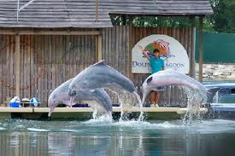
DOLPHIN ISLAND
Dolphin Island™ offers a range of programmes that gives you the opportunity to interact with Indo-Pacific Bottlenose dolphins and to learn about them. We’ll also share interesting facts about the measures we take to look after these amazing animals and how our learnings contribute to research and conservation efforts around the world.

Slide 4
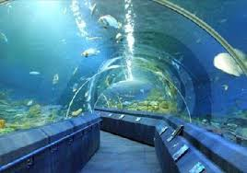
UNDERWATER WORLD
Be thrilled no end by unique encounters with marine animals. Feed gentle rays and sharks, defy gravity feeding fishes through openings at the side of the MAGIC-T tank, spot masters of disguise like the amazing mimic octopus, allow giant isopods to crawl all around you and even tunnel under the sea on an 83m long voyage to the colourful Reef and Ocean Colonies!
What's more, meet with our other residents of Dolphin Lagoon – the adorable fur seals as they perform alongside pink dolphins. They’ll gamely shake hands and pose for photos afterwards! Don't forget to catch our Meet-the-Dolphins and Fur Seals LIVE! performances at the following time slots too!

Slide 5
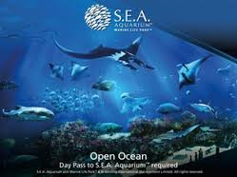
S.E.A AQUARIUM
Discover the awe-inspiring world of life in the ocean at the world’s largest aquarium. Step into S.E.A. Aquarium and immerse yourself in a magical marine world seen through our planet’s largest window to the ocean. With more than 800 species of marine animals, the aquarium is home to majestic manta rays, enormous goliath grouper, napoleon wrasse, and other gentle giants of the sea. Come face-to-face with over 200 sharks and uncover the centuries of myths about these ocean predators. Sneak a peek at a moray eel in a rocky crevice or tour an underwater reef community. Discover and unfold the endless wonders of our blue planet at S.E.A. Aquarium.
Adventure Cove Waterpark and S.E.A. Aquarium - attractions under Marine Life Park S.E.A. Aquarium, Resorts World, the Resorts World logo and all Resorts World elements and related indicia™ & © Genting International Management Limited. All Rights Reserved.

Slide 6
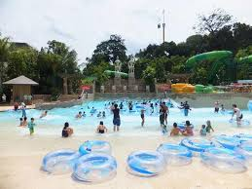
ADVENTURE COVE
Promising endless splashes of fun, Adventure Cove Waterpark is an aquatic adventure park with something for everyone. Feel the adrenaline rush as you zoom down thrilling waterslides such as Southeast Asia’s first hydro-magnetic coaster. Chill out with friends at Bluwater Bay wave pool, or grab a tube and journey down Adventure River, passing through 14 stunning scenes including a tropical jungle garden and a grotto inhabited by whimsical sea creatures. Snorkel over a colourful coral reef with 20,000 friendly fish or wade amongst dozens of rays as you touch their velvety wings. For a day of wet and wild fun in the sun, come and experience it all at Adventure Cove Waterpark.
Adventure Cove Waterpark and S.E.A. Aquarium - attractions under Marine Life Park Adventure Cove Waterpark, Resorts World, the Resorts World logo and all Resorts World elements and related indicia™ & © Genting International Management Limited. All Rights Reserved.

Slide 7
4D ADVENTURELAND
Home to UNLIMITED FUN! Go on in an immersive 4-D movie, NEW: Journey 2: The Mysterious Island, The 4-D Experience.
Next, Hang On Tight as you ride on a virtual 4-D roller coaster “Extreme Log Ride” and Grab a motion-sensor pistol, aim and fire at Asia’s first 4-D Interactive Shoot-Out game happening at “Desperados”.

Slide 8
Click HERE to go to the OFFICIAL WEBSITE.

